Slide 1

SAN FRANCISCO CRIME DATA
Julie Maria Petersen

Slide 2
DATA SCIENCE PIPELINE PIPELINE
COLLECTION
Integration of different sources
PREPARATION
Cleaning, missing values, anomalies, outliers and transformations
EXPLORATION
Patterns and trends across different dimensions
MODELLING
Machine learning algorithms
EVALUATION
Performance of models and validation
DEPLOYMENT
MLOps and maintenance
1
2
3
4
5
6

Slide 3
DATA SCIENCE PIPELINE PIPELINE
COLLECTION
Integration of different sources
PREPARATION
Cleaning, missing values, anomalies, outliers and transformations
EXPLORATION
Patterns and trends across different dimensions
MODELLING
Machine learning algorithms
EVALUATION
Performance of models and validation
DEPLOYMENT
MLOps and maintenance
1
2
3
4
5
6

Slide 4
2 Preparation
Clean and transform

Slide 5
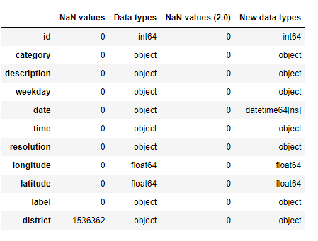
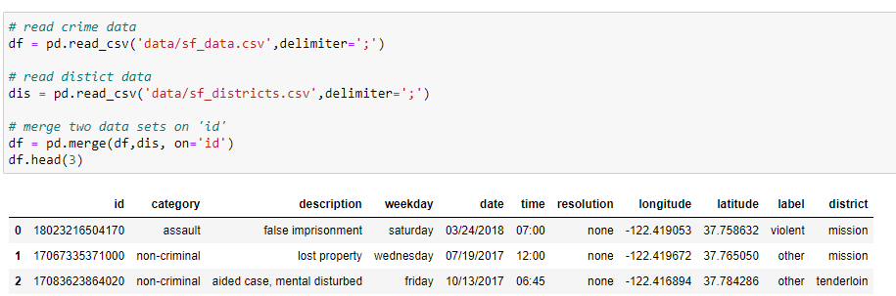
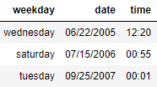
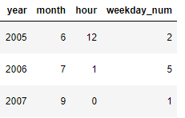
Initial overview and cleaning
Check for and replace missing values
Transform time variables
2
3
Rows: 2129216
Columns: 11
Time range: 2003/01/01 -2018/05/15
4
5
Import and merge data
Add time variables
5

Slide 6
3 EXPLORATION
Trends across time and space

Slide 7
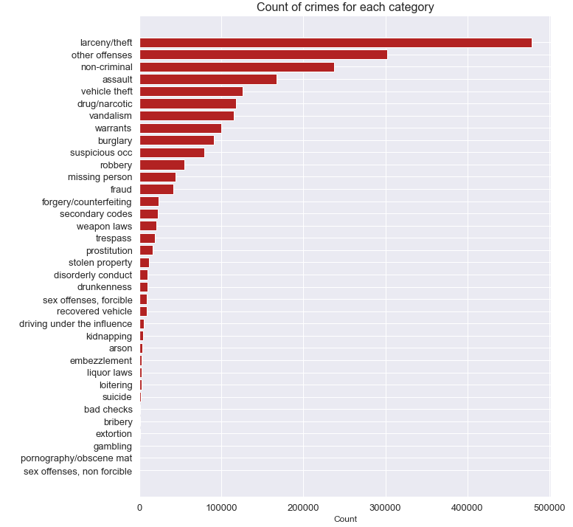
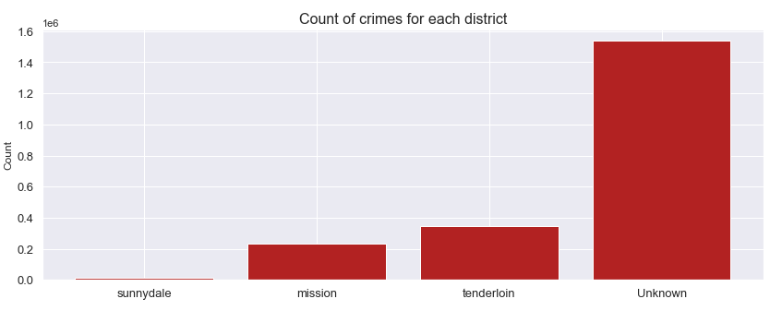
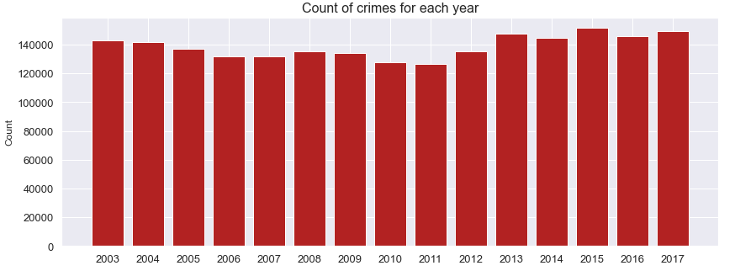
Overall distribution of crimes
2
3
4
5
7

Slide 8
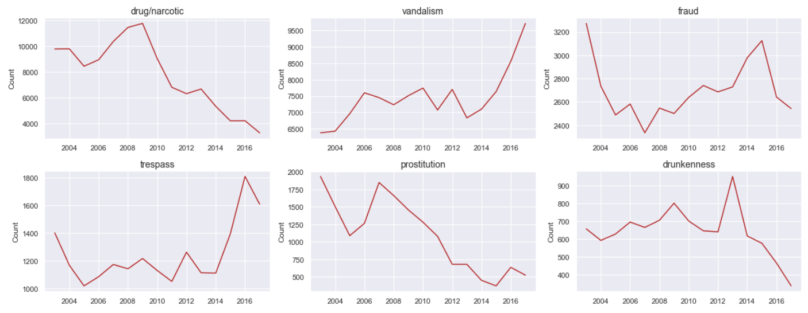
Yearly patterns
2
3
4
5
8

Slide 9
Yearly patterns
2
3
4
5
9

Slide 10
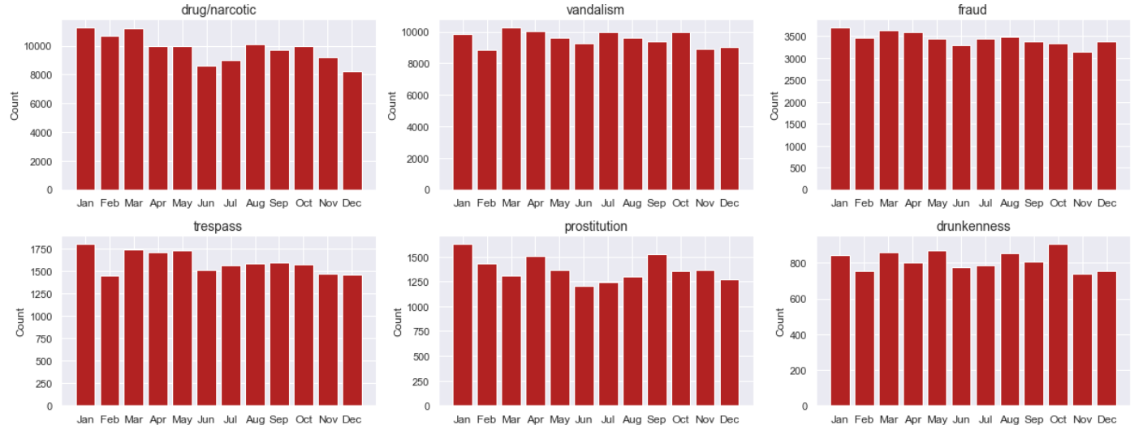
Monthly patterns
2
3
4
5
10

Slide 11
Monthly patterns
2
3
4
5
11

Slide 12
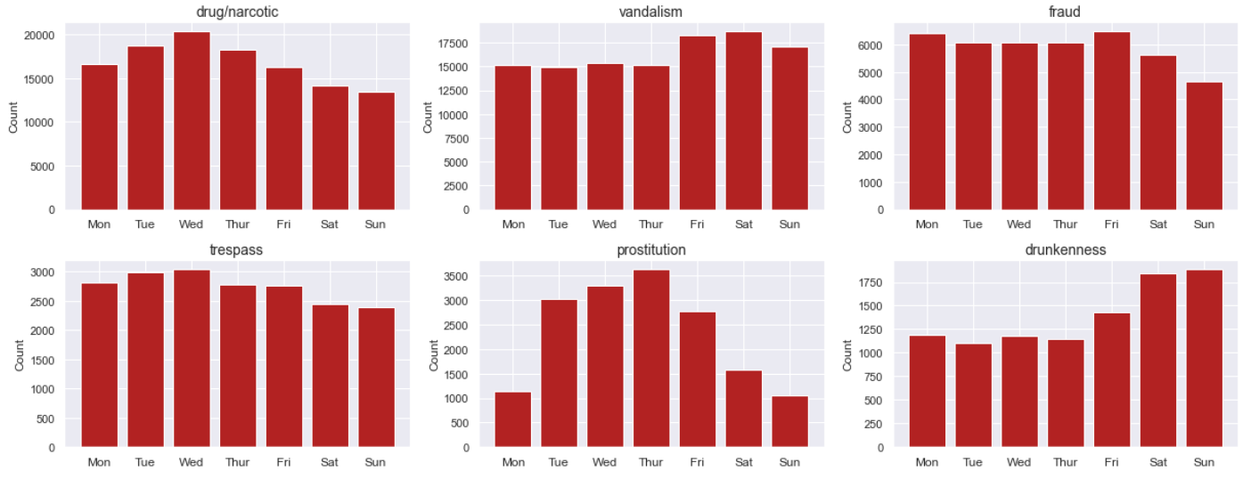
Weekly patterns
2
3
4
5
12

Slide 13
Weekly patterns
2
3
4
5
13

Slide 14
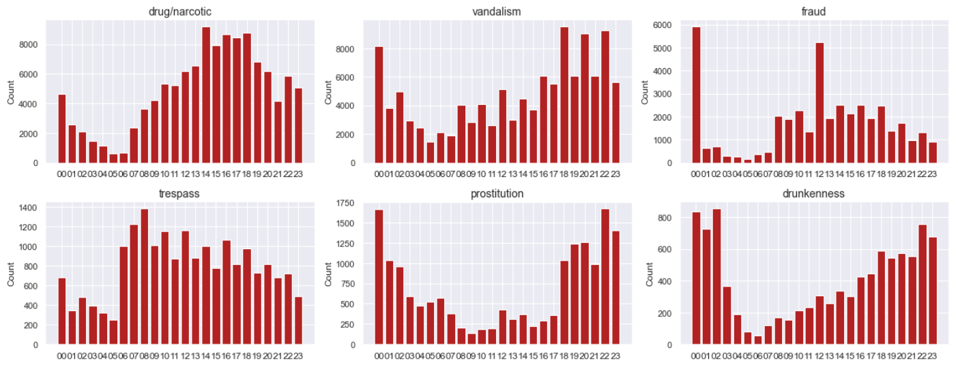
Hourly patterns
2
3
4
5
14

Slide 15
Hourly patterns
2
3
4
5
15

Slide 16
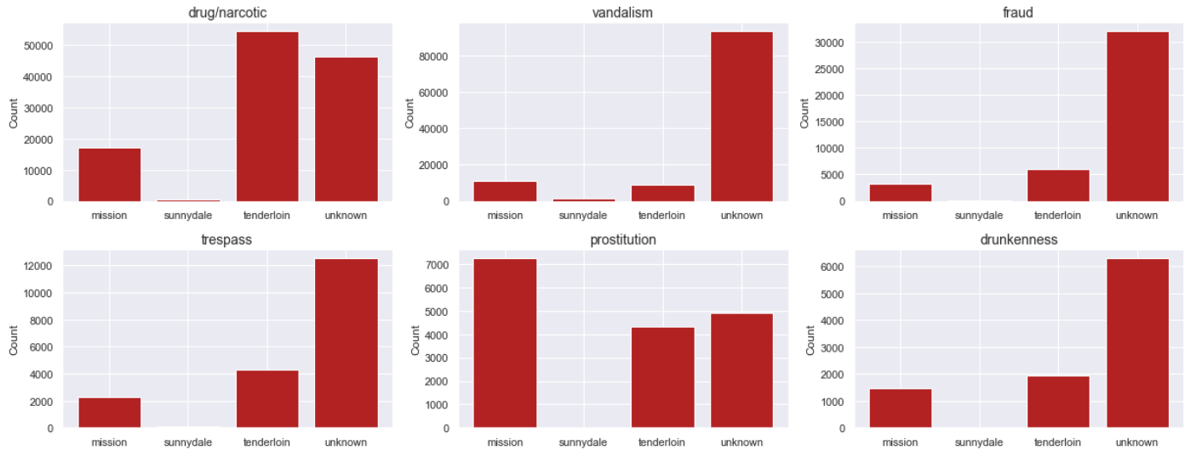
Crimes across districts
2
3
4
5
Year 2017
16

Slide 17
Crimes across districts
2
3
4
5
Year 2017
17

Slide 18
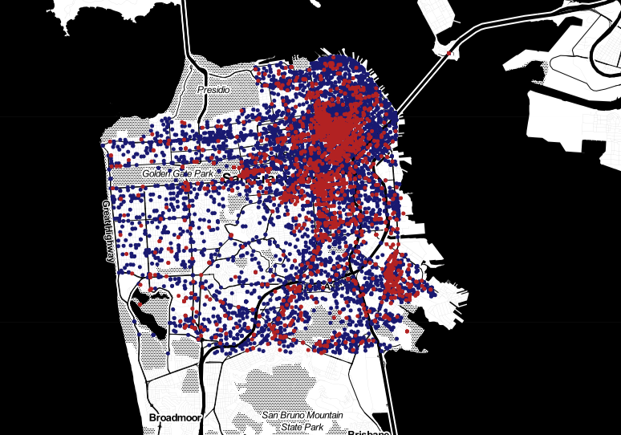
Mapping of crimes
2
3
vandalism
4
drug/narcotic
5
Year 2015
18

Slide 19
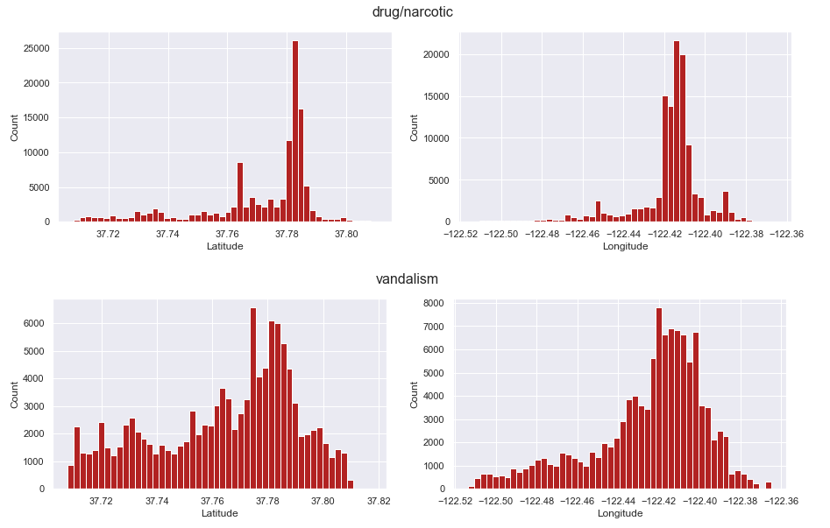
Spread of coordinates
2
3
4
5
Year 2015
19

Slide 20
4 MODELLING
Crime category classification

Slide 21
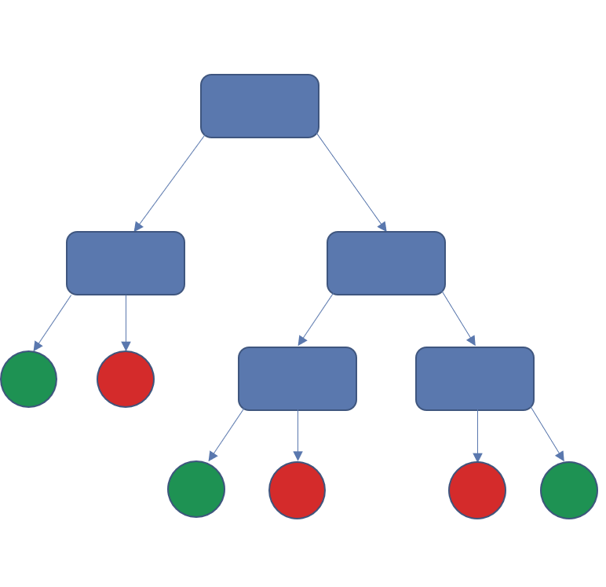


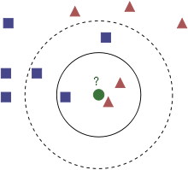
Predict type of crime based on location and time
2
Features
Classes
3
4
5
District
Longitude
Random Forest (RF)
Latitude
VANDALISM
114705
?
DRUG/NARCOTICS
117810
Month
Weekday
K-nearest neighbors (KNN)
Hour of day
21

Slide 22
5 EVALUATION
Performance of models

Slide 23
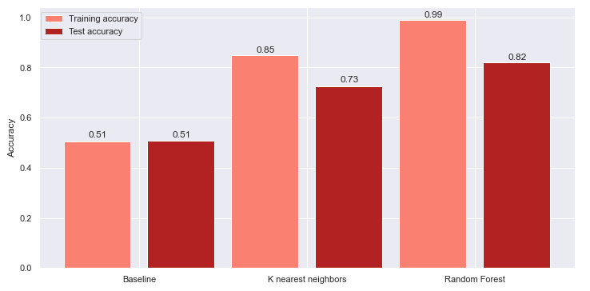
Performance of models
2
3
Using 80/20 training/test split
Models were trained on training set and evaluated on test set
4
5
23

Slide 24
Potential next steps
2
3
Map coordinates to more districts to avoid ‘unknown’
Improve model performance by e.g.
Cross validation
Hyperparameter tuning
Adding more features (e.g. weather data, demographics)
Removing features
Try other algorithms
Explore and model other crime categories
Explore other variables like description, resolution and label
4
5

Slide 25

THANK YOU

